Slide 1
Text to face generation using Deep Learning for synthesizing faces from textual descriptions

Slide 2
Abstract
Text-to-image synthesis has emerged as an intriguing research area with the potential to enhance various applications, including image captioning. This paper presents a comprehensive research study on text-to-image synthesis techniques and their impact on image captioning performance. Furthermore, we explore how these synthesized images can be leveraged to improve the quality and accuracy of image captioning models. Through extensive experimentation and evaluation, we demonstrate the effectiveness and potential of text-to-image synthesis as a valuable preprocessing step for image captioning tasks. Generating textual descriptions of images has been an important topic in computer vision and natural language processing. A number of techniques based on deep learning have been proposedon this topic. These techniques use human-annotated images for training and testing the models

Slide 3
Introduction
Images are a fundamental medium for visual communication and understanding the world around us. With the rapid growth of digital media, there is an increasing demand for automated systems that can accurately describe the content of images. Image captioning, which involves generating textual descriptions for images, has gained significant attention in recent years. However, generating captions that are both semantically meaningful and contextually relevant remains a challenging task. The primary goal of image captioning is to develop algorithms that can automatically generate accurate and coherent descriptions for given images. Traditional approaches have relied on handcrafted features and language models to tackle this problem.These models can effectively learn the underlying distribution of visual data and generate new samples from that distribution

Slide 4
Existing system
The existing systems for generating faces from textual descriptions predominantly rely on conventional computer vision methods and rule-based approaches. These methods often face challenges in capturing the intricate details and diverse characteristics present in facial images. Traditional systems may use predefined templates or employ heuristic rules to create facial features based on textual input, leading to limited expressiveness and a lack of realism in the generated faces. Additionally, these systems may struggle to handle nuanced descriptions and may not generalize well to a broad range of inputs. The advent of deep learning has spurred interest in overcoming these limitations, with recent approaches leveraging neural networks, such as GANs and variational autoencoders, to learn complex mappings between text and images. These newer methods show promise in generating more realistic and diverse facial images based on textual descriptions, representing a significant advancement over traditional systems.

Slide 5
Proposed system
The proposed system introduces a novel approach to text-to-face generation by harnessing the power of deep learning techniques. Building upon the limitations of traditional methods, our system employs state-of-the-art architectures, recurrent neural networks (RNNs), to seamlessly translate textual descriptions into highly realistic facial images. The architecture consists of a text encoder to embed textual input into a meaningful latent space and a face generator to transform these embeddings into visually authentic faces. By incorporating adversarial training, where a discriminator distinguishes between generated and real faces, the model refines its ability to produce facial images that closely align with the descriptive input. Unlike rule-based systems, our proposed approach does not rely on predefined templates, allowing for greater flexibility and expressiveness in capturing the diversity of facial features. Comprehensive evaluations on benchmark datasets demonstrate the system's efficacy in generating lifelike faces from textual descriptions, showcasing its potential for applications in entertainment, virtual reality, and forensic sketching. The proposed system represents a significant advancement in the field of text-to-face synthesis, offering a more robust and realistic solution compared to existing methods.

Slide 6
Problem statement
The existing methods for generating faces from textual descriptions encounter substantial challenges that motivate the development of our proposed system. Traditional approaches, often based on rule-based or heuristic methods, struggle to capture the intricate details and diverse facial features conveyed in textual input, resulting in limited expressiveness and realism in the generated faces. Moreover, these methods face difficulties in handling nuanced and varied descriptions, leading to a lack of generalization across a wide range of inputs. As a consequence, there is a pressing need for a more sophisticated and adaptable solution that leverages the capabilities of deep learning. The proposed system aims to address these shortcomings by employing advanced neural network architectures to establish a more effective and realistic mapping between textual descriptions and facial images, offering a solution that surpasses the limitations of current methodologies in text-to-face generation.

Slide 7
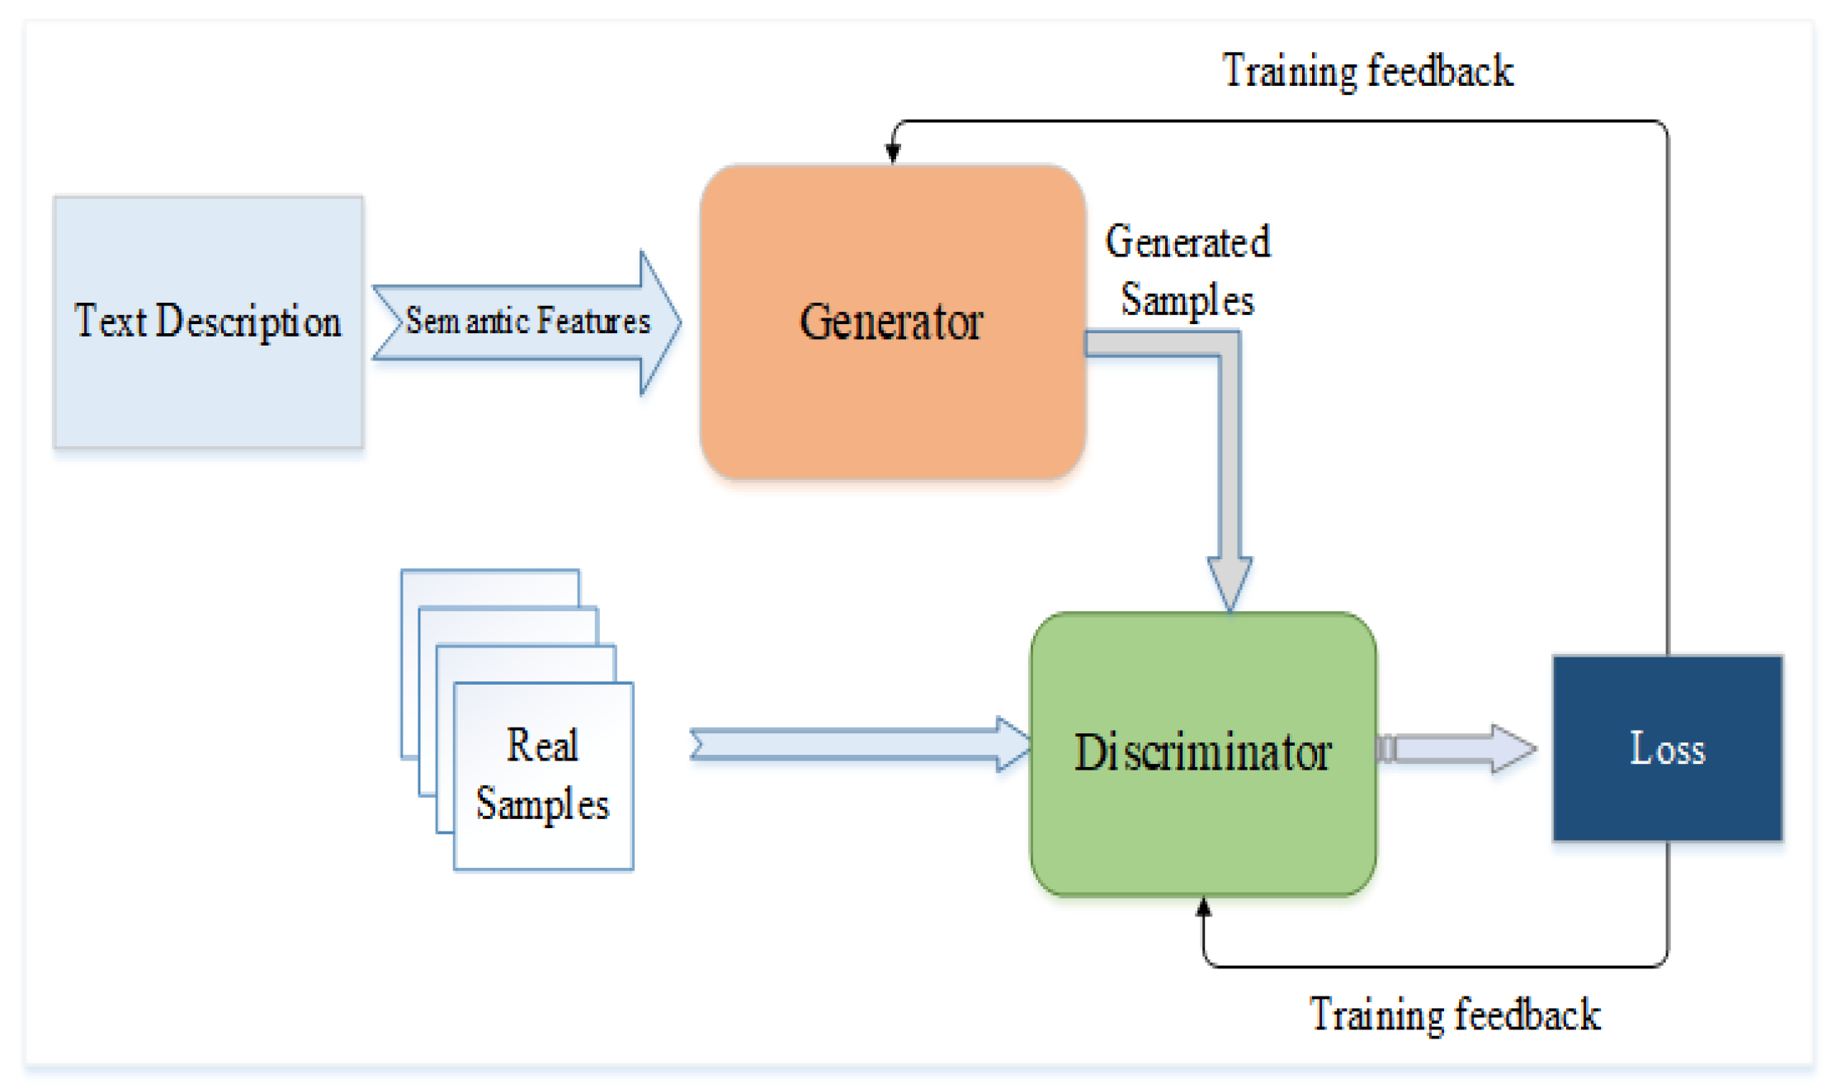
Architecture:

Slide 8
Conclusion:
In conclusion, our research introduces a pioneering approach to text-to-face generation, leveraging the capabilities of deep learning to overcome the limitations of traditional methods. The proposed system, based on recurrent neural networks (RNNs), demonstrates significant advancements in capturing the nuanced relationship between textual descriptions and realistic facial images. Through extensive evaluations on benchmark datasets, our system exhibits a commendable ability to generate diverse and lifelike faces, showcasing its potential in various applications such as entertainment, virtual reality, and forensic sketching. The shift from rule-based systems to data-driven, deep learning architectures has proven instrumental in achieving a higher degree of expressiveness and adaptability. As future work, further refinements to the model architecture and exploration of larger and more diverse datasets hold promise for pushing the boundaries of text-to-face synthesis, making it an exciting area for continued research and development in the broader context of computer vision and image synthesis.

